Slide 1
Sydney Python Meetup Building an End to End Secure, Scalable IoT Serverless Solution
Dave Glover,
Microsoft Australia
Cloud Advocate
Follow me @dglover
https://github.com/gloveboxes/Integrate-IoT-Edge-Classifier-with-Python-Azure-Functions-and-Azure-SignalR

Slide 2
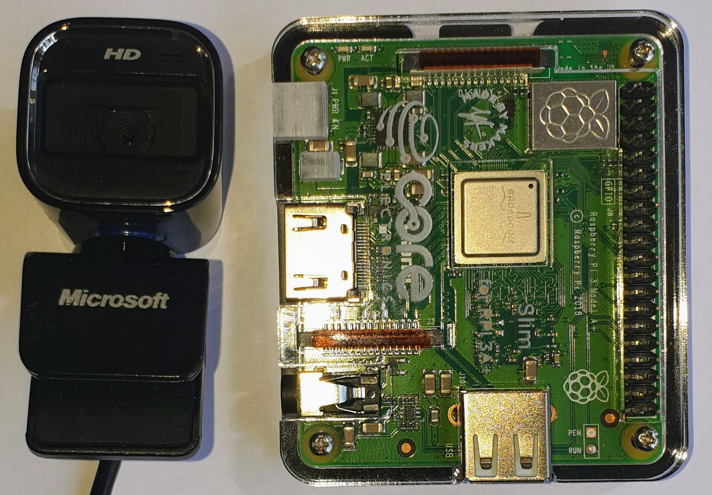

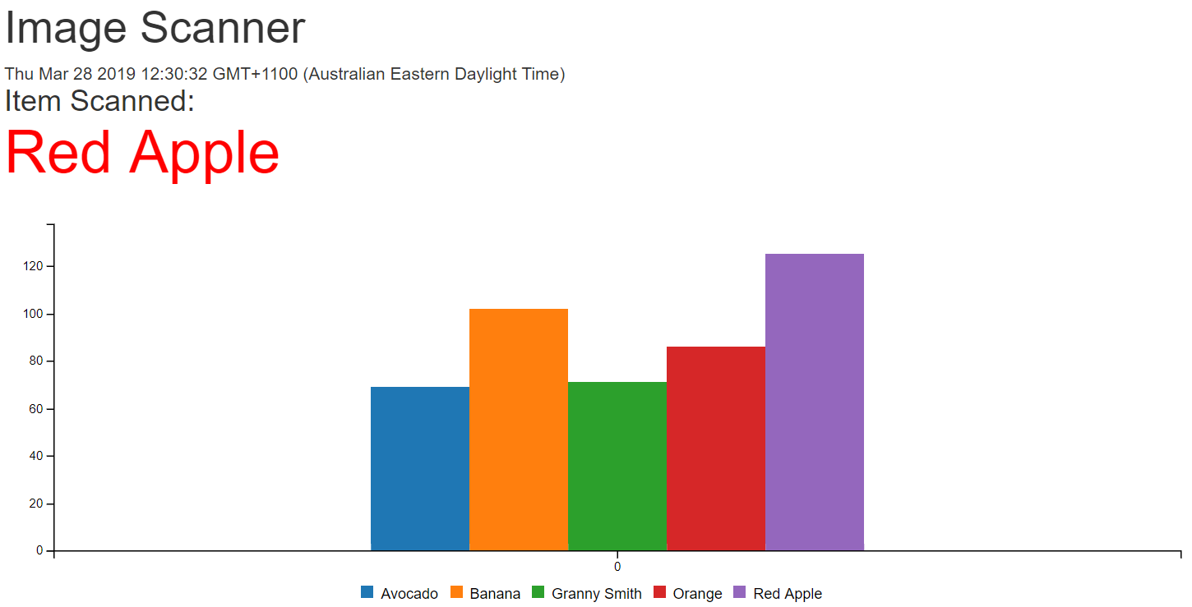
What we will cover
Python Image Recognition
(Azure IoT Edge)
Serverless & Azure Functions
Serverless Websites
(Azure Storage Static Websites)

Slide 3
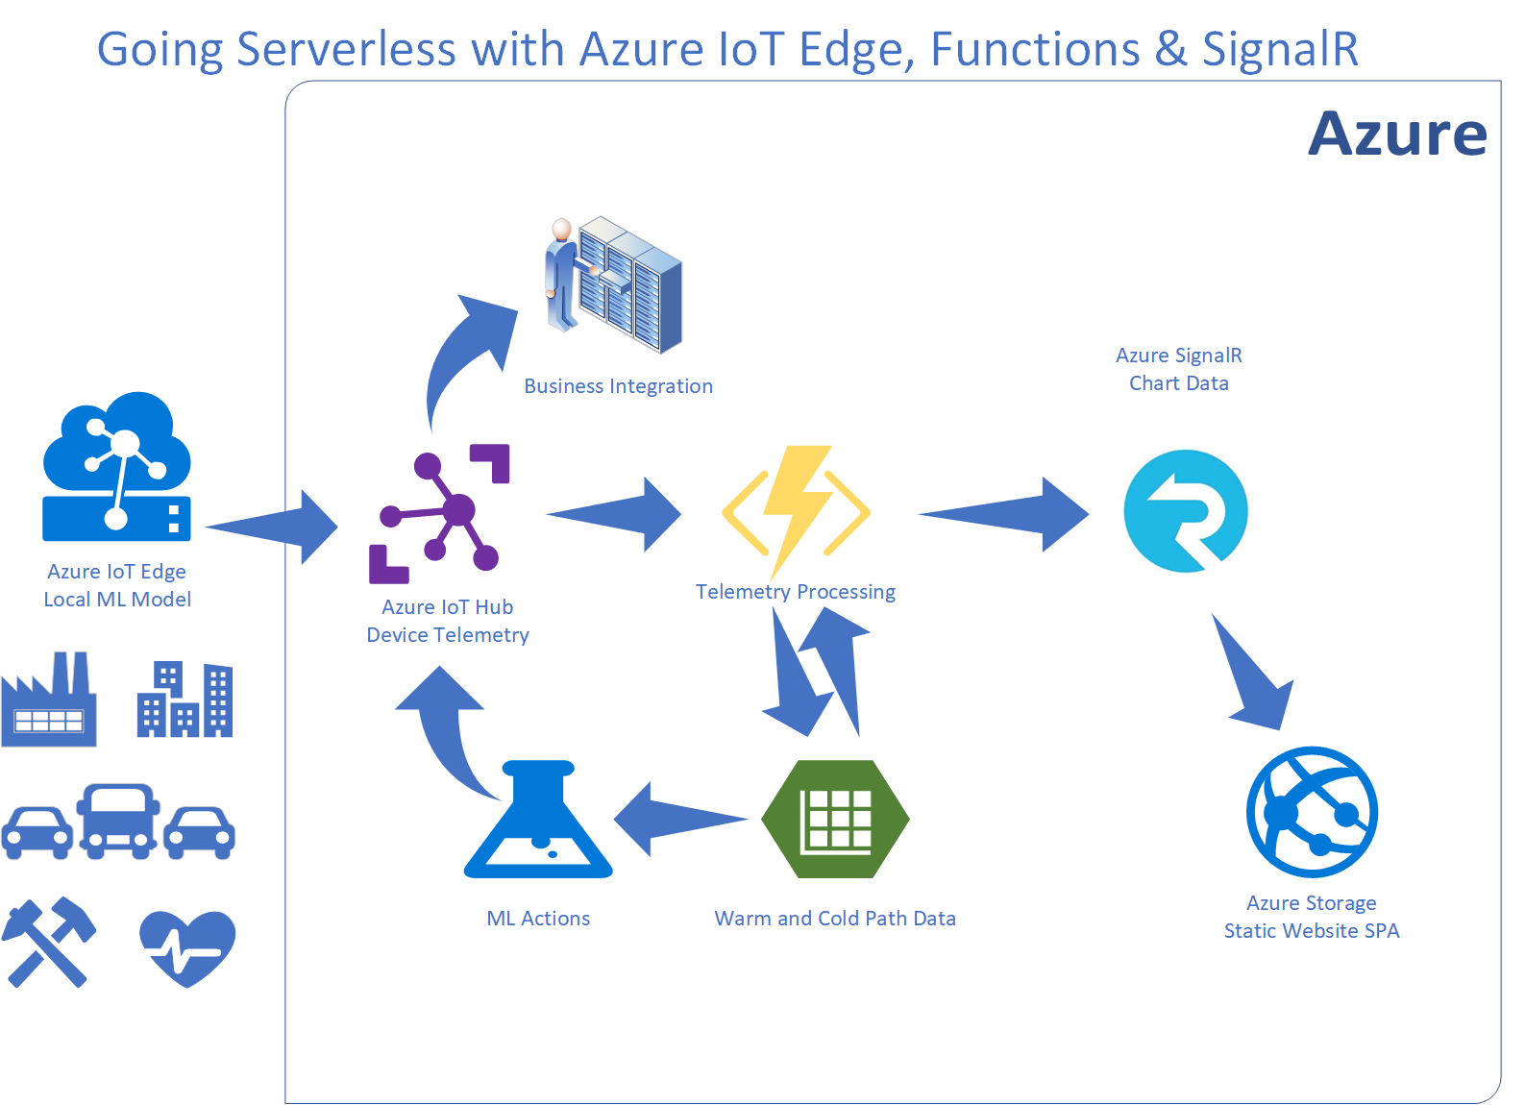
Integration IoT and Business

Slide 4
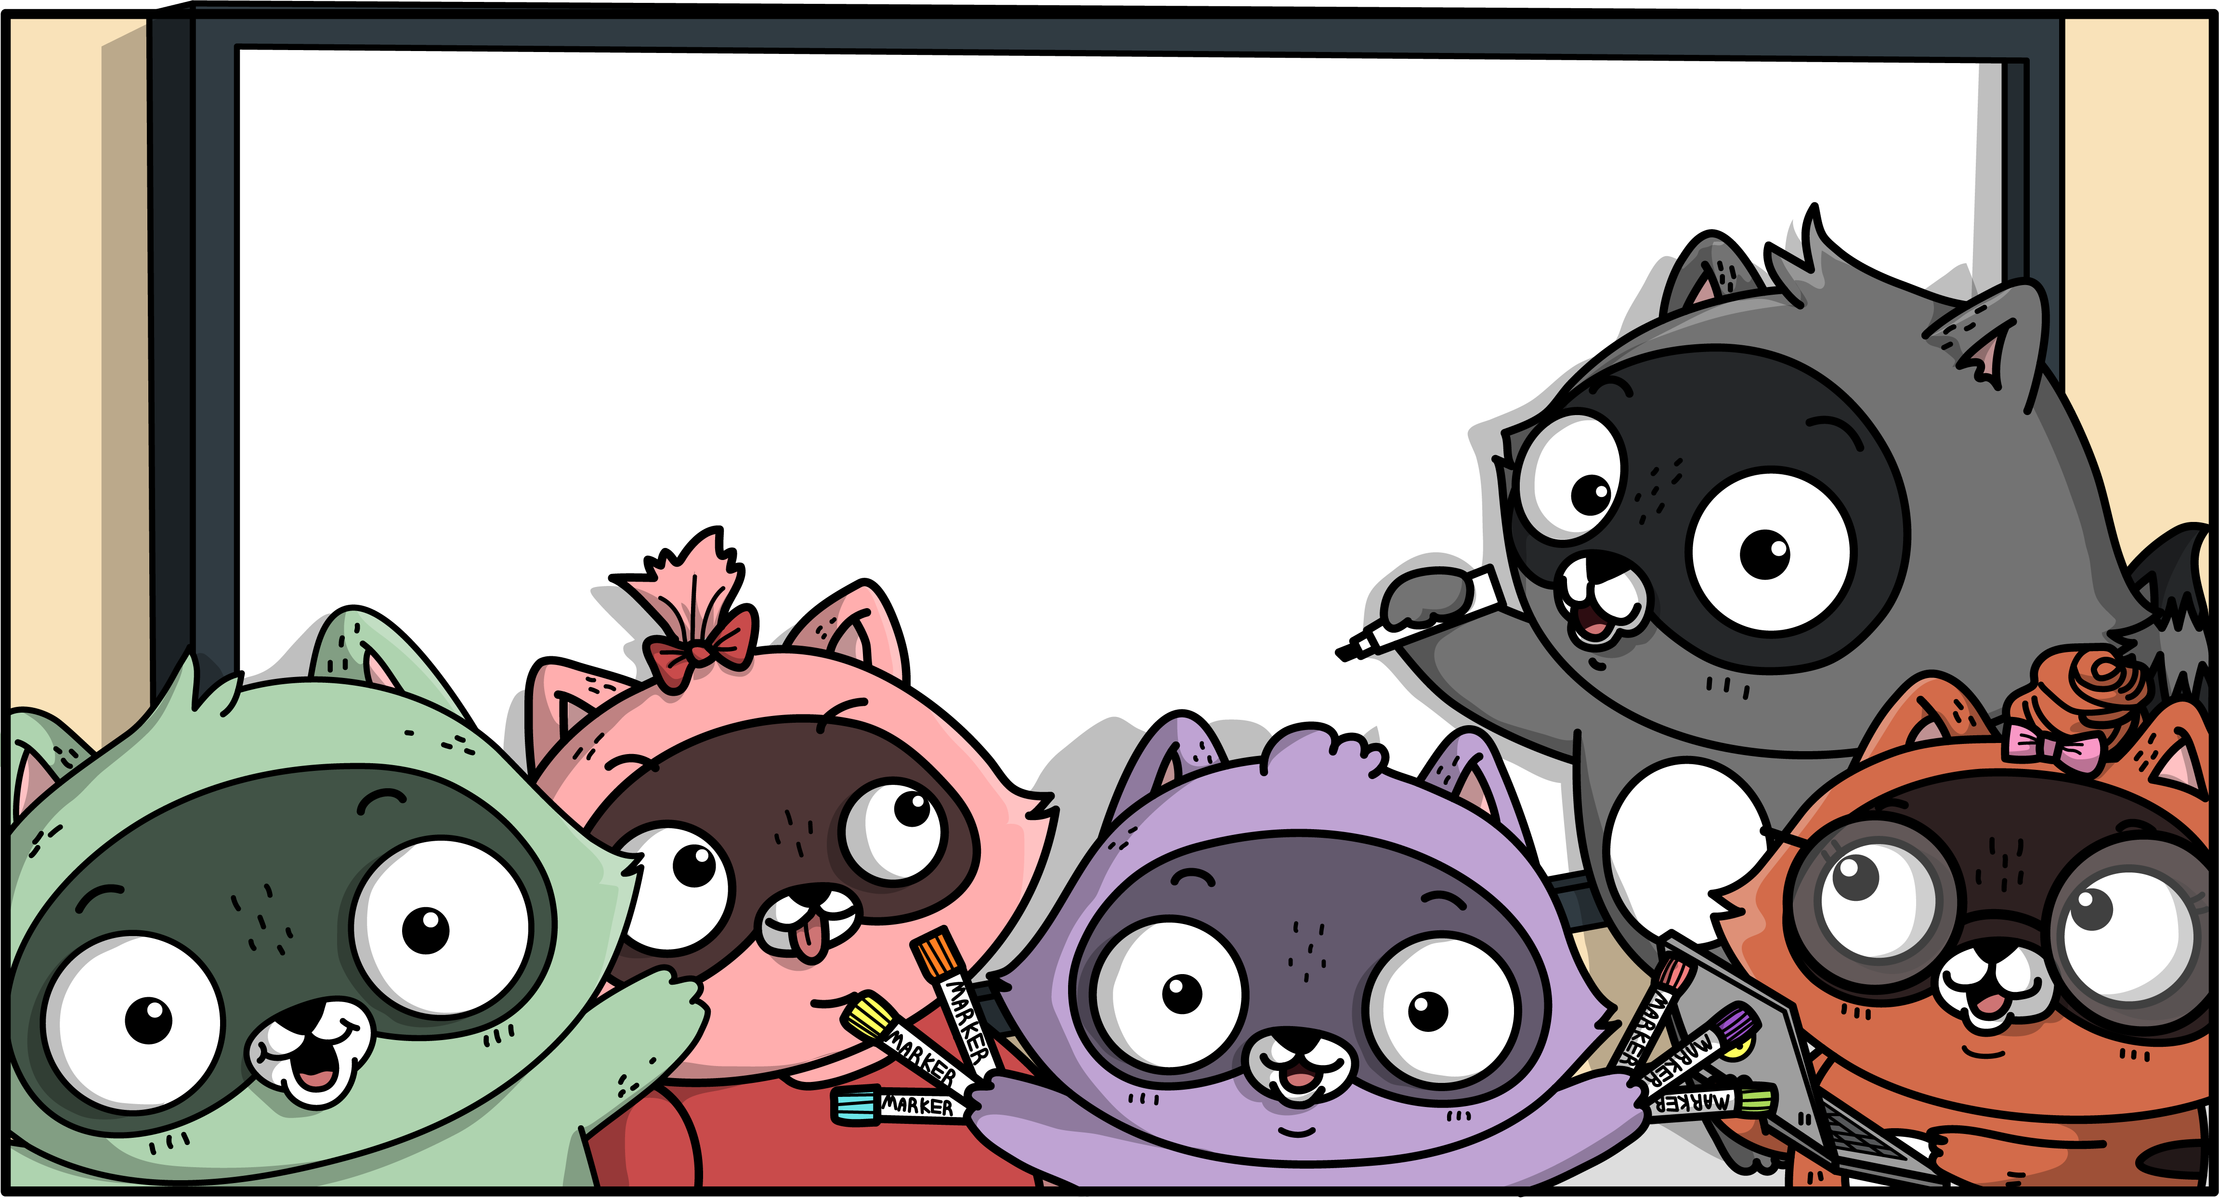


Slide 5
Python & Custom Vision AI and Azure IoT Edge

Slide 6
Python Image Recognition
Azure Custom Vision AI
Exported Python Container
Free Tier
https://www.customvision.ai/
Azure IoT Edge (IoT Hub)
Manages Deployment, Health, Updates
Docker Based
Open Source
Free Tier
Azure IoT Certified HW
Notes:
Peripheral nervous system: The portion of the nervous system that is outside the brain and spinal cord. Abbreviated PNS. The nerves in the PNS connect the central nervous system (CNS) to sensory organs, such as the eye and ear, and to other organs of the body, muscles, blood vessels, and glands. The peripheral nerves include the 12 cranial nerves, the spinal nerves and roots, and the autonomic nerves. The autonomic nerves are concerned with automatic functions of the body, specifically with the regulation of the heart muscle, the tiny muscles that line the walls of blood vessels, and glands.

Slide 8
Serverless with Azure Functions

Slide 9
What is Serverless?
No infrastructure headaches
Scales on demand
Very cheap to run

Slide 10

Functions as a Service (FaaS)
Functions as a Service
Single Responsibility, Short Lived, Stateless, Event Driven & Scalable
Azure Functions (Implementation of FaaS)
Great Local Developer Experience
Hosting Flexible
Consumption Plan, App Service Plan, Premium, and Container
Consumption plan
Free grant of 1 million requests and 400,000 GBs per month
Open Source https://github.com/Azure/Azure-Functions

Slide 11
Notes:
Using Visual Studio Code to build Python Functions
Debugging Experience
Deploying to Azure

Slide 12
Serverless Web Pages & Azure SignalR

Slide 13


SignalR in Action
Azure IoT Hub
Azure Function
Telemetry Processor
Azure SignalR Service
Browser
Desktop
Mobile
Game
Event Hub Trigger
SignalR Output Binding
WebSocket, Server Sent Events,
and Long Polling

Slide 14
Notes:
SignalR Trigger
Azure Storage Static Websites and Single Page Apps

Slide 15
Session Summary

Slide 16
Resources
Create your first Python function in Azure
Azure Custom Vision AI
Azure SignalR Service Documentation
Static website hosting in Azure Storage
Demoed Solution on GitHub (gloveboxes)
Azure Functions Python Worker

